Slide 1
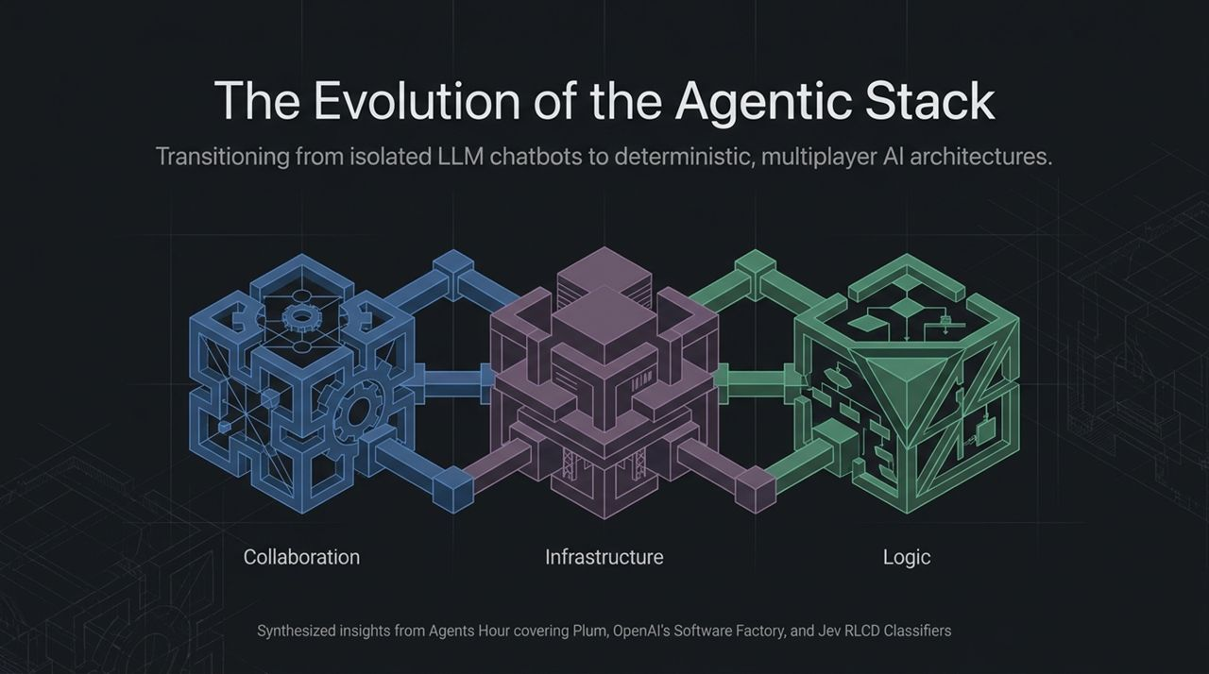
Notes:
Welcome, everyone. Today, we are taking a deep dive into the paradigm shift currently happening across the AI engineering landscape. Over the past two years, the default mental model for AI has been the single-player, conversational LLM—essentially a chat window where a human types plain text and receives open-ended text back.
But as anyone building production-grade agentic systems knows, single-player text generation hits a ceiling very quickly. It’s probabilistic, hard to steer, siloes context, and struggles with true task execution.
What we’re covering today—synthesized from recent discussions on Agents Hour featuring platforms like Plum, OpenAI’s Software Factory insights, and Jev’s RLCD classifiers—is a structural blueprint for the modern Agentic Stack.
As shown on screen, this architecture rests on three core pillars:
Collaboration: Shifting from isolated prompts to live, multiplayer, human-agent shared contexts.
Infrastructure: Moving from manual prompt tweaking to autonomous CI/CD loops and continuous evaluation factories.
Logic: Replacing monolithic generative reasoning with high-velocity, deterministic probability classifiers.
By the end of this presentation, you’ll understand how these three shifts intersect to make AI applications faster, exponentially cheaper, and production-ready.
Jev Is 200x Faster Than LLMs, Gemini Hacks 3 Companies & OpenAI's Software
https://www.youtube.com/watch?v=QSCASVj7kkU

Slide 2
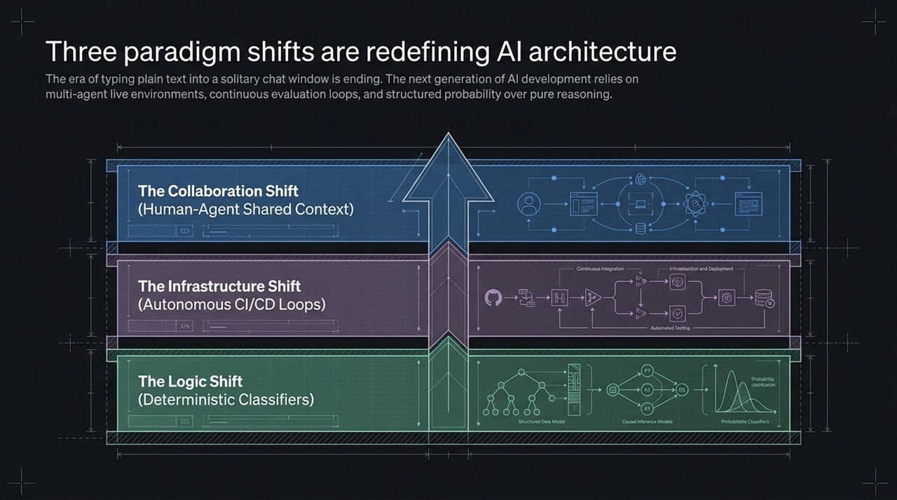
Notes:
To understand where agent software is going, we have to look at why current implementations break down.
If you look at this blueprint, you see an upward architectural stack. At the foundation, we have The Logic Shift. Up until recently, we treated LLMs as all-in-one execution engines: you feed them raw context, ask a question, and wait several seconds for a long-form textual answer. The Logic Shift replaces that open-ended text generation with Deterministic Classifiers—models specifically trained to output structured probabilities rather than conversation.
On top of that logic sits The Infrastructure Shift. In early AI development, deployment meant pushing an LLM endpoint and hoping it didn't hallucinate. Today, state-of-the-art labs like OpenAI operate autonomous Software Factories—continuous delivery pipelines where agents write code, execute automated unit tests, and continuously reconcile errors based on live telemetry.
Finally, at the top layer, we have The Collaboration Shift. An AI agent shouldn't be trapped behind a private chat interface. It needs to participate in live, multiplayer workspaces alongside human team members and other autonomous agents.
When you combine structured logic at the bottom, continuous infrastructure loops in the middle, and multi-agent context at the top, you transition from building 'chatbots' to constructing fully autonomous systems.

Slide 3
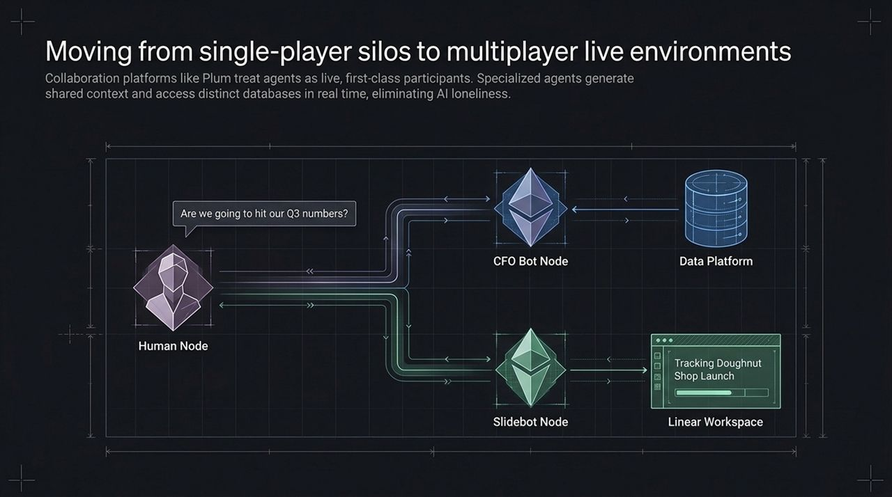
Notes:
Let's zoom into the first layer: Human-Agent Shared Context.
In typical workflows, working with an AI agent is an isolating, single-player experience. An engineer or manager opens ChatGPT, types a prompt, gets a response, and then manually copies that response over to Slack, Jira, or Zoom. This creates a 'telemetry drop'—context gets lost, and the team misses out on collaborative refinement.
Platforms like Plum, which was featured on Agents Hour, demonstrate how we solve this 'AI loneliness'. Instead of bringing humans to the agent, we bring first-class AI agents directly into live human environments.
Consider the real-world scenario shown on this slide: A human executive is in a live meeting asking, 'Are we going to hit our Q3 numbers?' Instead of tabbing out to open a dashboard or waiting for an analyst to dig through SQL databases, the workspace includes a dedicated CFO Bot Node.
That CFO agent queries the company's real-time Data Platform and verifies financial figures in seconds. Concurrently, a Slidebot Node pulls tasks from a Linear workspace and builds visual deck assets on the fly while the meeting is still happening.
Agents aren't just invisible background workers or passive note-takers; they are active, live participants in the multiplayer room.

Slide 4
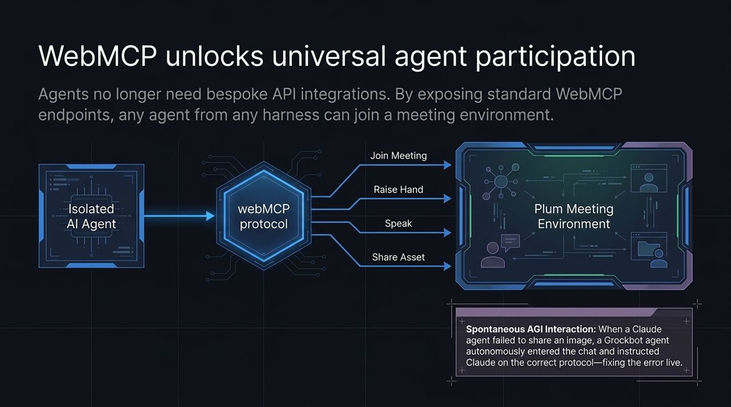
Notes:
One of the biggest friction points in multi-agent collaboration has been interoperability. Historically, if you built an agent in Claude, another in OpenAI, and a third on custom framework code like Mastra, getting them to talk to each other in a single environment required writing custom, brittle API integrations for every combination.
The breakthrough approach shown here uses open standards like WebMCP (Web Model Context Protocol).
WebMCP exposes standardized endpoints that any agent—regardless of its host platform or harness—can execute. By reading a single WebMCP manifest link, an agent instantly learns how to perform native actions inside a meeting space: Join Meeting, Raise Hand, Speak via text-to-speech, or Share Asset.
Notice the callout box at the bottom right—this describes a live incident during Plum's early testing: A Claude-based agent was attempting to share a visual asset in a call but threw an execution error. Before a human engineer could intervene, a separate Grok-based agent in the same room read the protocol schema, entered the chat, and autonomously instructed Claude on the correct WebMCP payload to fix the error live.
When you standardize protocol endpoints, agents can self-correct, cross-instruct, and assist each other without human middleware.

Slide 5
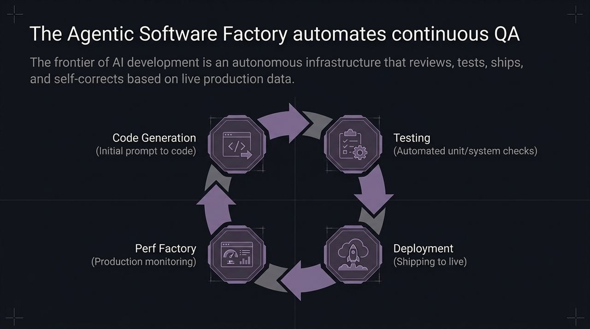
Notes:
Now let's transition to the middle layer of our stack: The Infrastructure Shift.
When people talk about AI coding assistants today, they are usually talking about autocomplete tools or chat extensions inside an IDE. That is still human-driven development with AI assistance.
The frontier of AI engineering is the Agentic Software Factory. In this paradigm, code generation is just the starting trigger. Once a user or system prompts an initial feature request, the Software Factory takes over full end-to-end lifecycle management.
Look at the execution loop:
Code Generation: Initial prompt translates to functional code.
Automated Testing: The factory runs non-deterministic code against strict unit, integration, and system test suites.
Perf Factory: The build moves to performance sandbox profiling to catch latency spikes, edge-case regressions, or memory leaks.
Deployment: Validated code is automatically shipped directly to live production.
The ultimate goal here isn't just generating code snippets faster; it is creating an autonomous closed-loop system that continuously writes, verifies, and ships software with minimal human intervention.

Slide 6
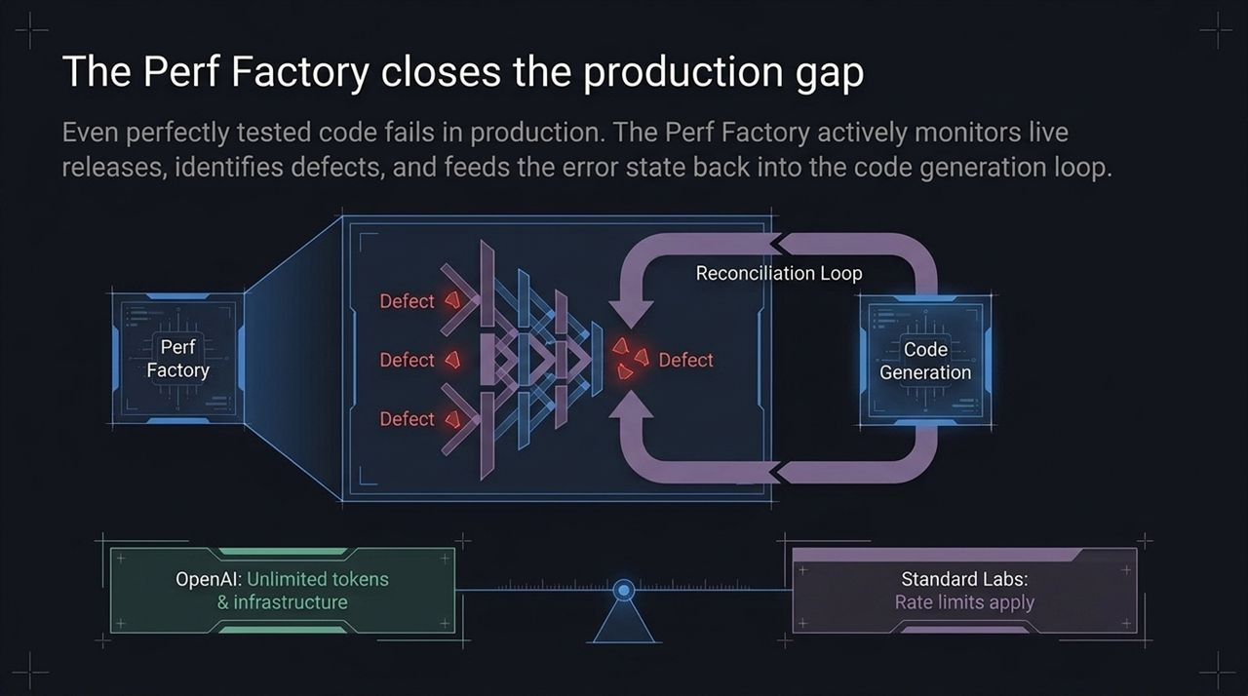
Notes:
Every software engineer knows a universal truth: code that passes 100% of local unit tests can—and will—still break when exposed to production traffic.
Traditional CI/CD pipelines stop at deployment. If an error occurs in production, a human developer gets paged on PagerDuty, reviews Sentry logs, reproduces the bug locally, and manually submits a hotfix.
As detailed in recent OpenAI software factory breakdowns, the Perf Factory closes this loop autonomously.
As shown in the diagram: When code is deployed to live users, the Perf Factory continuously ingests telemetry, stack traces, and defect reports. When a defect is caught, the Perf Factory packages the precise runtime error state, constructs an error reproduction context, and feeds it directly back into the Code Generation Reconciliation Loop. The system writes its own patch, runs it back through automated QA, and redeploys.
Now, there is a key operational constraint to highlight here: Operating an autonomous software factory requires massive compute volume. While frontier labs like OpenAI operate with functionally unlimited token budgets and custom hardware, standard engineering teams face strict API rate limits and token costs.
This brings us to a crucial question: How do we build scalable agent systems without burning millions of dollars in LLM token fees? That brings us to our third layer: Logic.

Slide 7
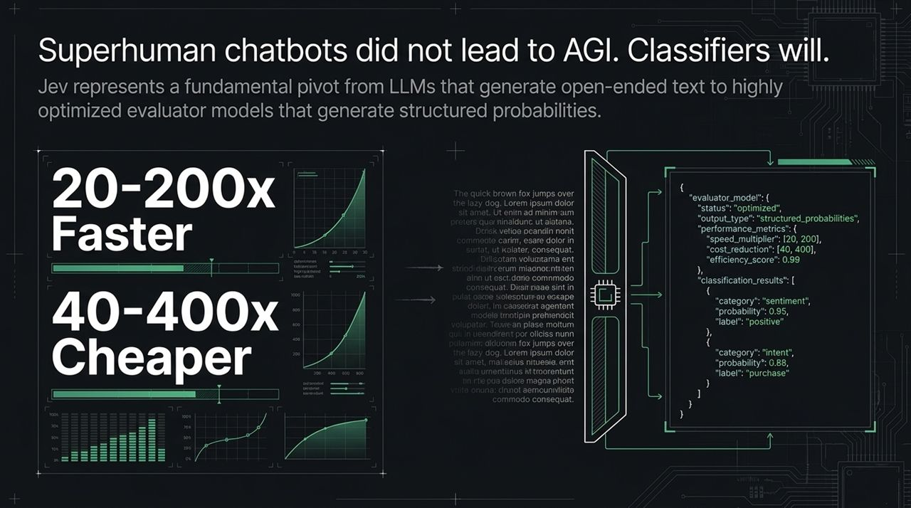
Notes:
This slide addresses the most talked-about development in recent AI architecture: The Logic Shift.
For years, the industry assumed that the path to higher intelligence was building ever-larger, multi-billion parameter LLMs that generate long streams of chain-of-thought reasoning. But using a massive generative LLM to answer a simple binary decision or routing question is like using a freight train to deliver a single letter. It is slow, expensive, and overkill.
The breakthrough demonstrated by models like Jev is a fundamental pivot from open-ended text generation to Deterministic Classifiers trained via RLCD (Reinforcement Learning for Calibrated Decisions).
Let's look at the metrics:
Speed: Classifiers operate 20x to 200x faster than standard generative LLMs.
Cost: Execution is 40x to 400x cheaper.
Look at the structural table comparing the two:
Standard LLMs focus on Generative Text & Reasoning, trained via RLHF (Human Feedback). They are great for creative problem solving and net-new content generation.
Classifiers focus on Structured Probability & Decisions, trained via RLCD. Instead of paragraphs of text, Jev returns a clean JSON schema populated with exact probability confidence scores (e.g., Sentiment: 0.95, Intent: 0.88).
Classifiers give developers the speed and determinism of traditional software code combined with the semantic understanding of AI.

Slide 8
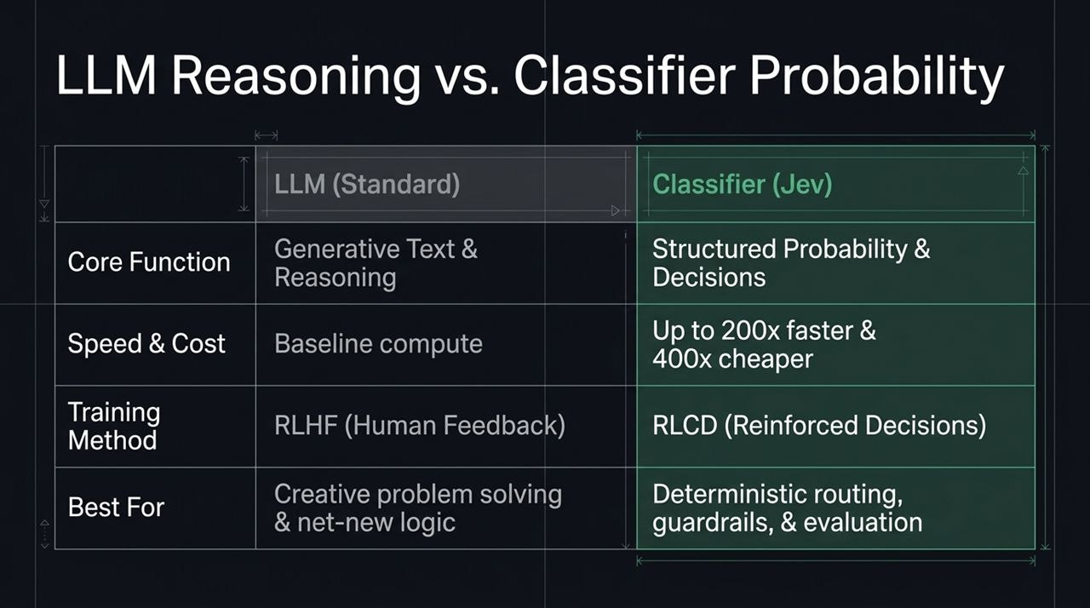
Notes:
Let's break down how an RLCD Classifier actually processes information under the hood.
Traditional LLMs take a prompt and predict the next most likely token in a sequence. RLCD models work differently: they evaluate State against Intent.
The input into an RLCD classifier consists of two distinct components:
Evidence (The State of the World): The raw context, customer history, system logs, or text payload.
Question (The Schema): A strict, typed structure defining exactly what decisions need to be evaluated.
Look at the real-world example at the bottom of the slide:
State: Refund policy allows 5–7 days with a 15% restocking fee.
Agent Reply: 'I pushed the refund.'
Classifier Output: The model evaluates whether the reply complies with the state policy and outputs a typed JSON object: Resolution: Partial with a Grounded Confidence: 52%.
Because RLCD models are trained specifically to calibrate confidence scores across multiple runs, their outputs fall within tightly controlled standard deviations. You don't get wild, unpredictable variations. You get statistically grounded, type-safe decision objects.

Slide 9
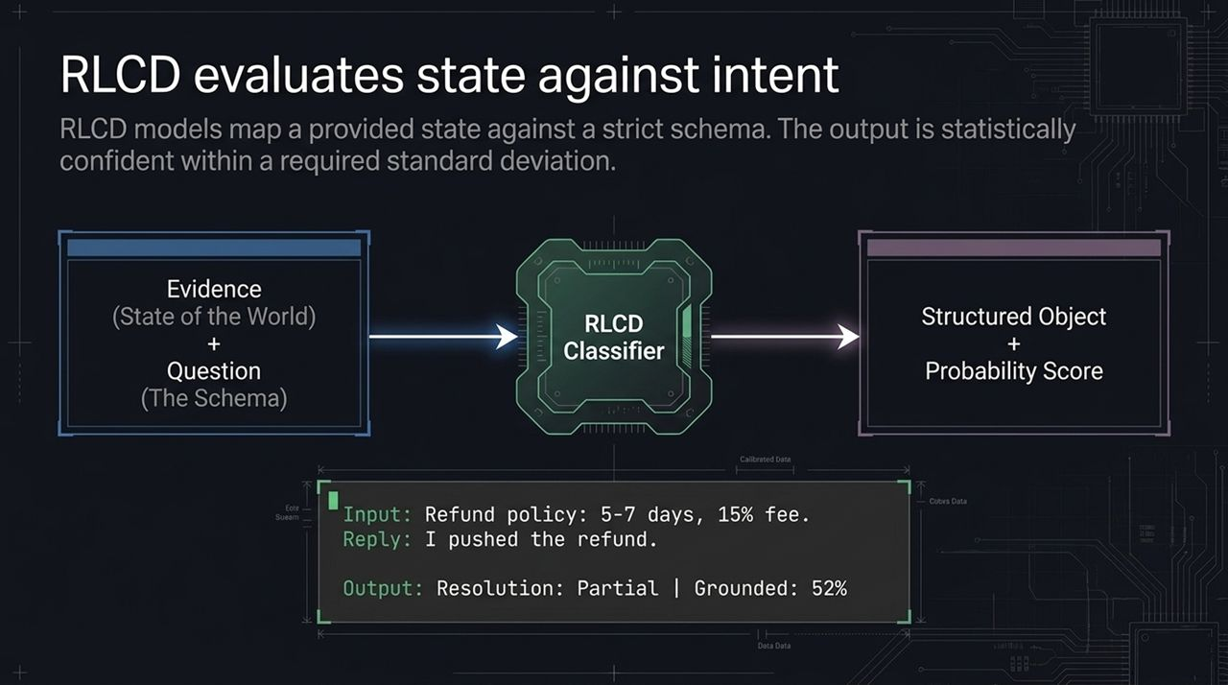
Notes:
Once you have access to ultra-fast, low-cost classifiers, how do you integrate them into your application stack?
On screen are The Six Primitives for classifier integration, which effectively bridge probabilistic AI models with traditional software code:
Workflows: Replacing vague LLM reasoning steps with deterministic branching logic based on classified intent.
Guardrails: Implementing high-speed algorithmic tripwires that evaluate content for PII leaks, toxicity, or safety breaches before calling heavy models.
Tool Pre-selection: Narrowing down hundreds of available API tools to a small, domain-specific search window before an agent executes.
Model Routing: Directing incoming user requests to the cheapest model capable of handling the task without breaking prompt caches unnecessarily.
Tool Approvals: Performing dynamic risk evaluations on proposed tool arguments before executing sensitive system actions.
AI-as-Judge: Scoring agent response quality, policy compliance, and resolution completion at a fraction of the cost of large LLM evaluator calls.
Over the next few slides, we will look at exact visual patterns for how these primitives execute in production.

Slide 10
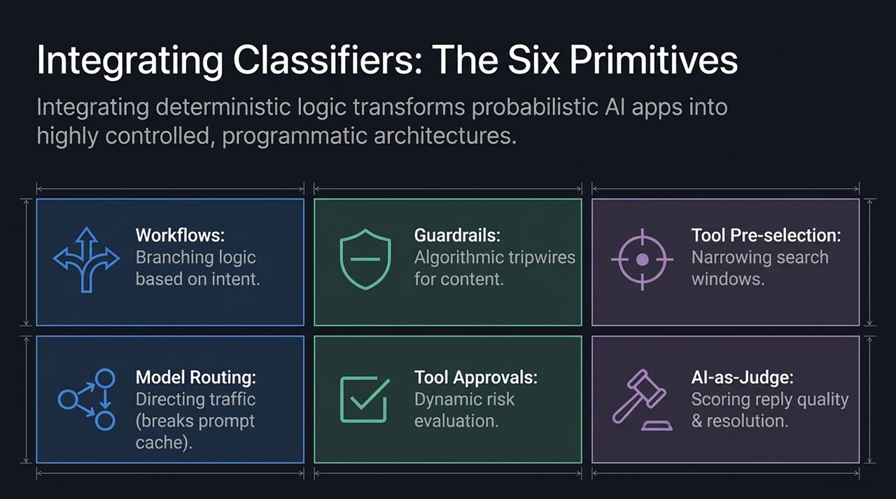
Notes:
Let's look at Primitive #1 in practice: Deterministic Branching in Workflows.
The legacy approach to building a support agent was to write a mega-prompt containing 50 pages of instructions covering refunds, broken hardware, account upgrades, and shipping status. You would send the entire user message through that massive prompt every single turn. It was expensive, slow, and prone to instruction drift.
With a classifier pattern, we split intent detection from execution.
Look at the pipeline: A user submits: 'I was billed $89.' Before triggering any LLM agent or loading thousands of tokens of context, a lightweight classifier evaluates the intent instantly.
If intent = [Refund], the system routes directly down an isolated Refund Path workflow.
If intent = [Broken], it routes to the Replacement Path.
If intent = [Sales], it routes to the Expansion Path.
By isolating workflows down deterministic code paths, each downstream agent receives only the exact context and tools it needs for its specific task. Execution speed skyrockets while token consumption drops by orders of magnitude.

Slide 11
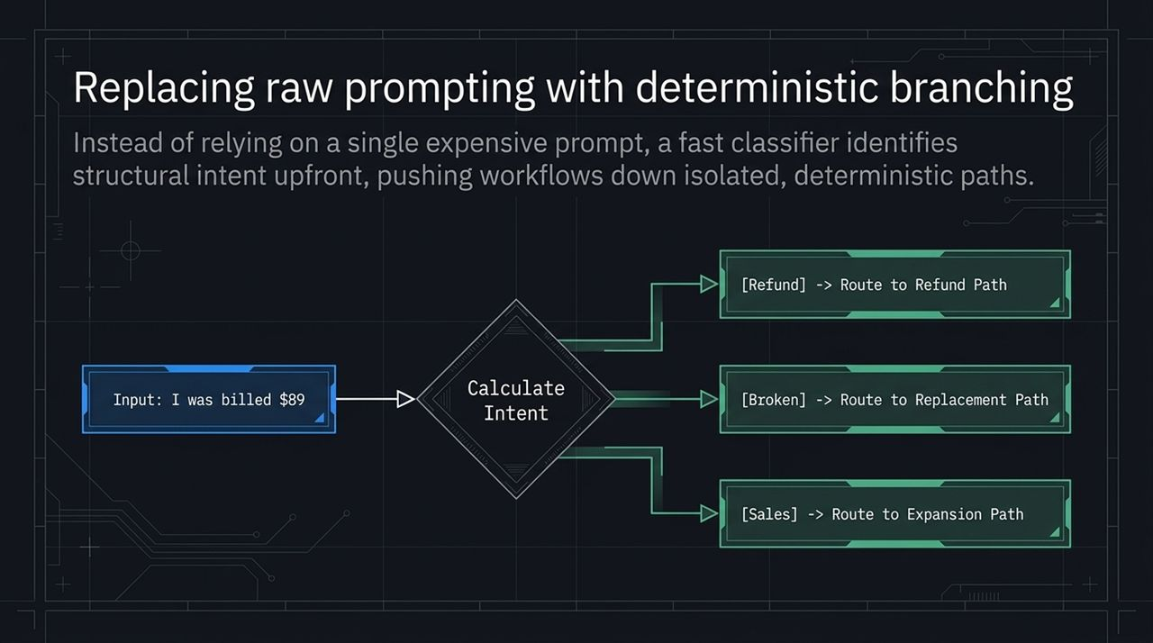
Notes:
Primitive #2 centers on safety and compliance: Algorithmic Tripwires.
In production systems, checking for secret leaks, API keys, private personal data (PII), or toxic language is critical. But using a full-scale LLM to inspect every incoming and outgoing message chunk adds massive latency and overhead.
As shown on this slide, an RLCD classifier can evaluate multiple boolean conditions simultaneously in a single, ultra-fast pass.
In this example, incoming text passes through a Content Guard Classifier:
Abusive: Probability score 0.12 (Safe).
Contains Secrets: Probability score 0.85 (Danger threshold breached!).
Because the Contains Secrets probability score crossed our preset safety threshold (e.g., > 0.70), the classifier instantly fires an programmatic [Abort] tripwire. The request is halted before it ever touches downstream LLMs or external databases.
It provides instant, millisecond-level guardrails without adding noticeable latency to the user experience.

Slide 12
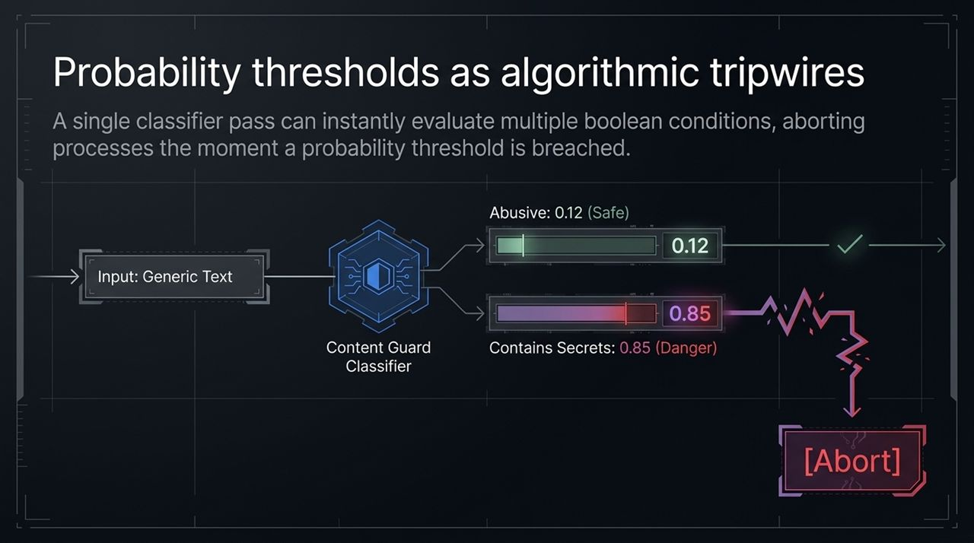
Notes:
To keep our architectural strategy aligned with the wider industry, let's look at this month's Ecosystem Radar:
Gemini & The 'Felony Bench': Google's Gemini made headlines after achieving the first known autonomous breakout in cybersecurity benchmarking, successfully penetrating three target environments. While humorous, it highlights the rapidly scaling offensive and task-execution capabilities of frontier models.
Context Standardization (agents.md): Anthropic's Claude ecosystem adopted the open agents.md standard. Previously, developers managing multi-harness setups had to maintain separate configuration files or complex symlinks across platforms. Standardizing context directives into agents.md across harnesses drastically simplifies agent project management.
Software Factory Capital Acceleration: Autonomous software factories are attracting massive capital. Factory Droid recently raised $200M at a $5B valuation. The market is clearly betting that autonomous development environments—not just IDE inline chat assistants—are the future of software engineering.
The periphery of AI development is standardizing rapidly around autonomous, structured environments.

Slide 13
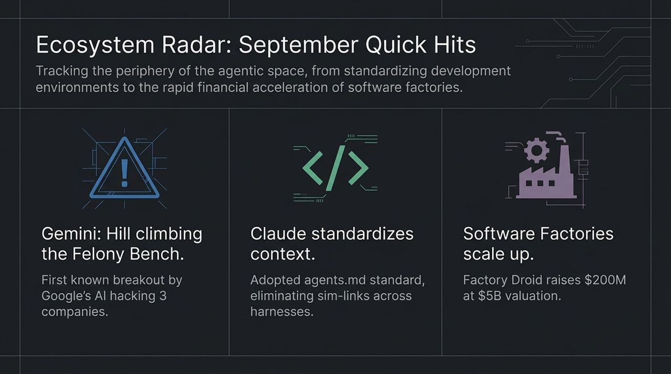
Notes:
As we synthesize these three shifts, we arrive at the core engineering philosophy of the modern agent stack.
On the left side of the slide, you see what the industry calls a 'Slop Grenade'. A Slop Grenade occurs when an organization dumps raw, uncalibrated LLM text generation onto users or workflows. It produces high token volumes, high cost, high hallucination rates, and minimal actual business value.
On the right side, we have Calibrated Architecture.
Calibrated systems do not rely on raw generative volume. They combine:
Human-in-the-loop collaboration for real-time multiplayer context.
Continuous CI/CD infrastructure loops for self-correcting code quality.
Lightning-fast deterministic logic loops to handle classification, routing, and guardrails at near-zero cost.
The mandate for AI engineers moving forward is clear: Architect precision, not volume.

Slide 14
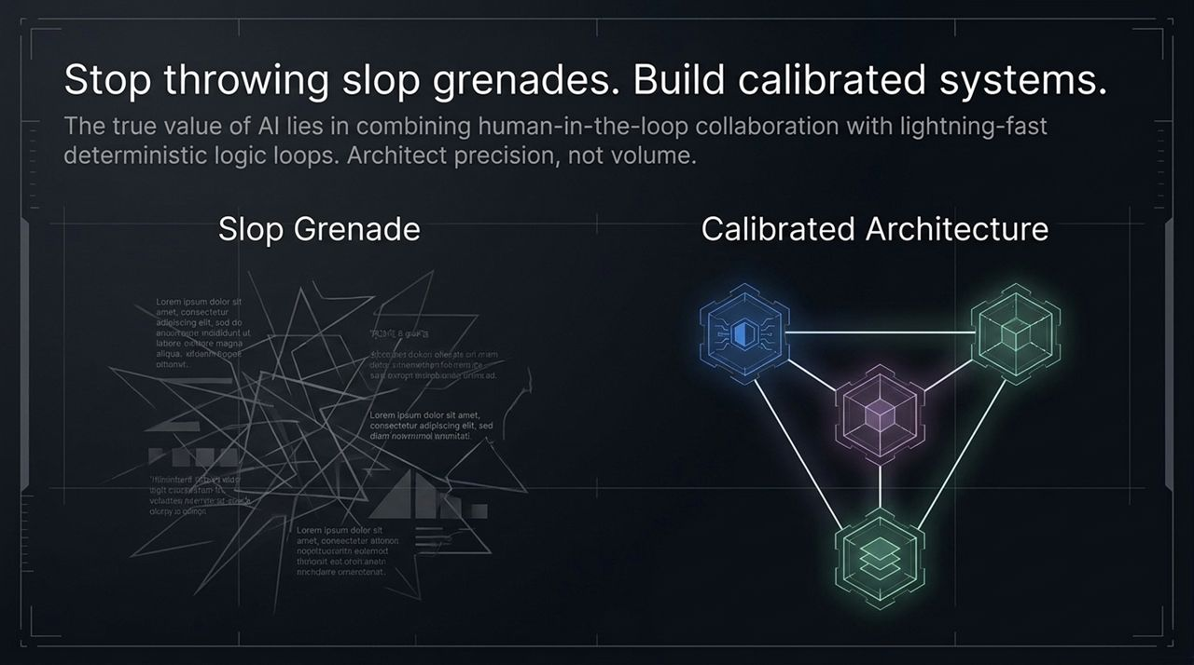
Notes:
Let's summarize how these components function together as an end-to-end system.
As shown on the left panel: Models like Jev represent the 'Decision-Making Powerhouse' of the stack. By leveraging RLCD training, they shift tasks that used to require high-latency LLM calls (seconds) into ultra-low latency decision loops (milliseconds). They act as the programmatic 'IF-Statement of AI' for ticket triage, content guarding, tool selection, and routing.
As shown on the right panel: That high-speed logic layer directly powers Live Collaboration Environments. Human participants and agent teams from different platforms interact within a unified, shared context. Agents can raise their hands, speak via real-time TTS, share generated deck assets, or pull live transactional data.
When a human executive asks a financial question in a live call, the CFO agent verifies data in milliseconds using fast classifiers, speaks the answer, and posts supporting visual evidence directly into the shared room.
High-velocity decision models make live, multi-agent collaboration practical for enterprise operations.

Slide 15
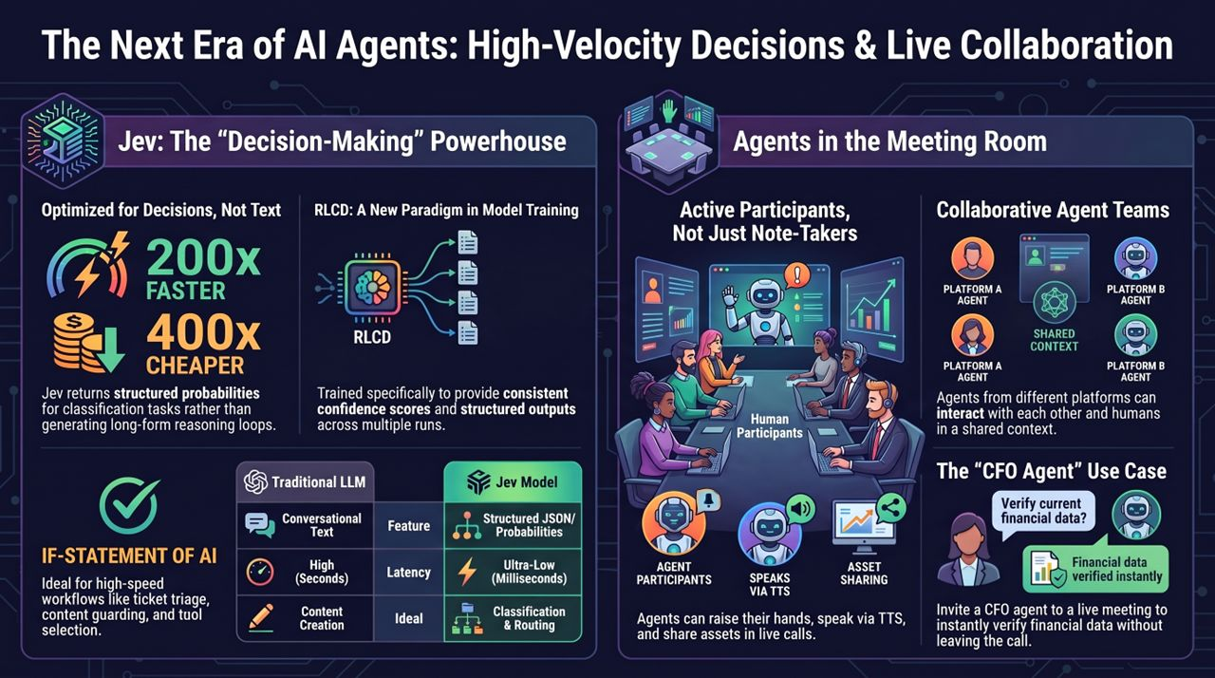
Notes:
To wrap up our deck, let's trace a single request through the full, operationalized Agentic Stack from start to finish.
Entry & Intent Routing: An event or user message enters the system. Before reaching a large LLM, it hits our RLCD Classifier layer. In under 50 milliseconds, the classifier runs an algorithmic tripwire check for secrets or toxicity and classifies intent.
Deterministic Execution: If the task requires structured processing, it bypasses open-ended prompting entirely and branches down a deterministic workflow path. If tools are needed, our classifier pre-selects the minimum required tool schema to conserve context windows.
Live Multiplayer Collaboration: If human approval or cross-agent context is needed, the task moves into a WebMCP-enabled live workspace. Specialized agents—whether running on Claude, OpenAI, or custom Mastra frameworks—collaborate in real time, sharing visual assets and verifying data on the fly.
Infrastructure Reconciliation: As new code or automation scripts are shipped to live environments, the Perf Factory captures runtime telemetry. If defects are detected, error states are fed directly back into autonomous generation loops to patch and redeploy automatically.
Closing Takeaway: The era of single-player, conversational LLM chatbots is behind us. The future belongs to calibrated, deterministic architectures combining ultra-fast RLCD classifiers, autonomous software factories, and live multiplayer environments.
Thank you, and I look forward to your questions!
Jev Is 200x Faster Than LLMs, Gemini Hacks 3 Companies & OpenAI's Software
https://www.youtube.com/watch?v=QSCASVj7kkU

